Slide 1
Monday, August 13, 2012
TISK Problems
Evaluate: $2\frac{3}{5}−4\frac{2}{3}$
Solve for x: $3x=51$
Write then solve an equation: Sedona has five fewer suckers than Tevante. If Tevante has 11 suckers, how many does Sedona have?
We will NOT have mental math questions today.
Be sure you have your post-it note out and ready to use today!

Slide 2
Homework Check
42) $\left(28−2\right)∙0=0$
43) $59−4∙\left(6−4\right)=51$
44) $\left(25−15\right)∙6+4=64$
45) $\left(22−4\right)∙3=54$
46) $81÷\left(9+18 \right)=3$
47) $108−17∙\left(2+3\right)=23$
48) 4
49) 34
50) 16
51) 32
52) 18
53) 18
54) 50
55) 20

Slide 3
Homework Grading
Heading
Is your heading on the paper correctly?
Do you have all the parts of the heading?
Did your write your First AND Last name?
Did you write the textbook section?
Problems
Have you copied the problems?
Can you tell what every problem wanted you to do without opening your book?
Work
Is there work to support each answer?
Answers
Are the answers clear and easy to find?
Did you answer in a complete sentence where required?
Complete
Has every problem been attempted?

Slide 4
Keeping Track of Graded Work
Record the date the work was due (which should be in your heading)
Record the name of the assignment For example: Homework 1-2
Record your score (for homework) or percentage points (for quizzes and tests)
Record your Points Earned/Points Possible
Homework is always out of 5 points
Quizzes are usually out of 50 points
Tests are usually out of 100 points
Total the Points Earned/Points Possible with the previous line.
If desired, calculate your percent.

Slide 5
Graphing with Coordinates
What are coordinates?
Two numbers, an x-coordinate and a y-coordinate, that represent the location of a point in the plane.
What is a coordinate plane?
Two axes, an x-axis which is horizontal and a y-axis which is vertical, that create an ordered grid used for locating points.

Slide 6
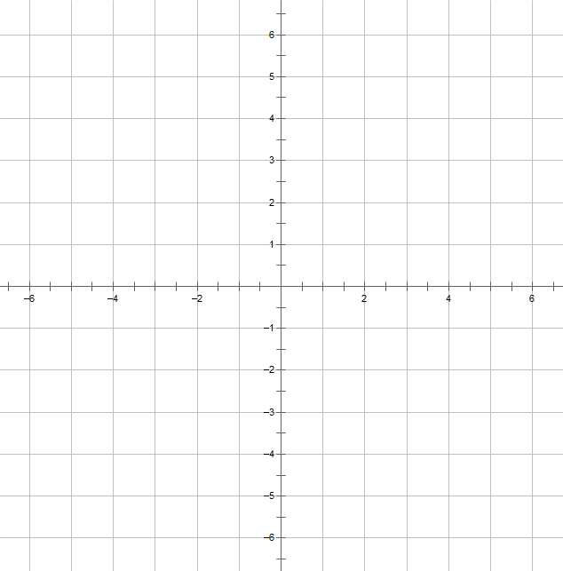
Graphing with Coordinates
How do you locate a point on a coordinate plane?
Find (-2, 4) then label it point A.
D
Find (5, -6) then label it point B.
Give the coordinates of point C.
C
Give the coordinates of point D.

Slide 7
Plotting Points
This is a “just for fun” practice assignment.

Slide 8
Missing Work Reports
Time to set your password!
A password must be at least 8 numbers and letters.
Write your password down in a safe place (like your planner) and bring it up to me when I call you.
While I am speaking with each person, you should work on the Plotting Points worksheet.

Slide 9
Homework
No Required homework tonight
Remember, this only means I will not be collecting anything tomorrow.
Study your notes.
Try some review problems from the Chapter Test in your book.
Read more about this lesson and come prepared with questions tomorrow.
Check the Test Calendar so you know when your test will be on this section.

